Slide 1
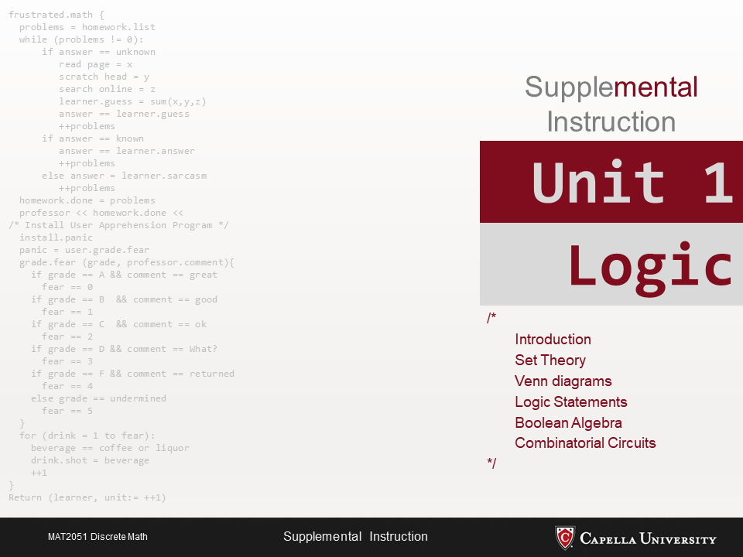

Slide 2
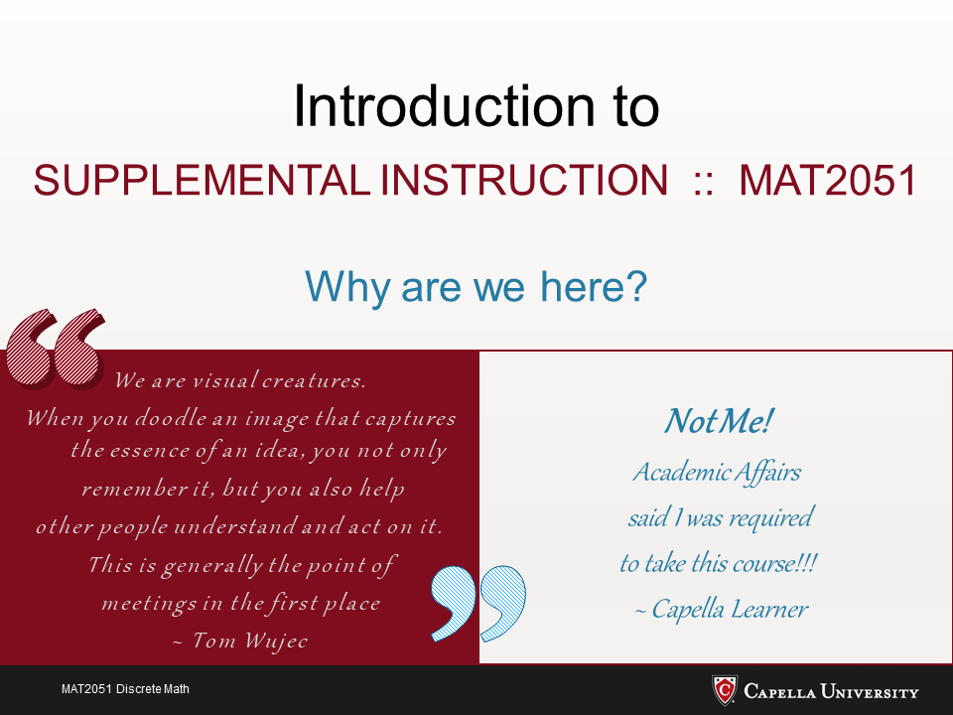

Slide 3
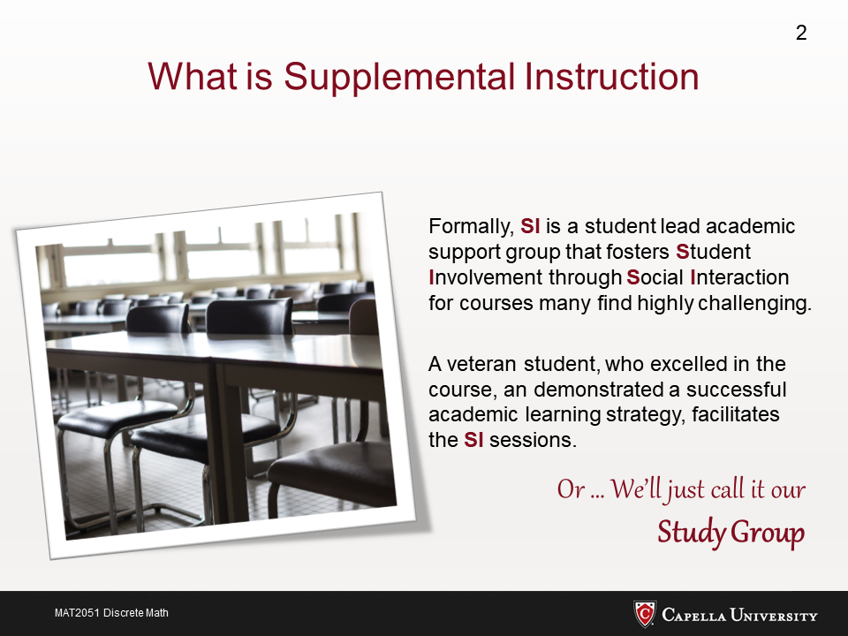

Slide 4
Who am I?
I’m Bary – I’ve been a faculty member here at Capella University since 2008
I earned by BS in Math from M.I.T. and my MS and PhD in Computer Science From Stanford University
I’m NOT the professor for this course – I’m only the guy leading the SI sessions

Slide 5
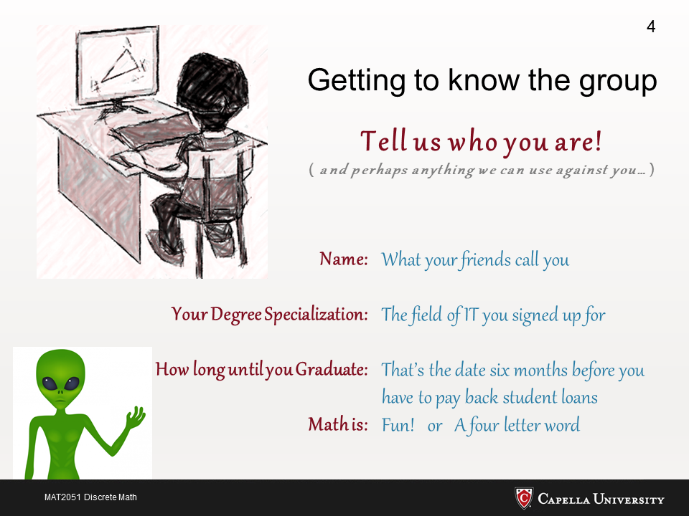

Slide 6
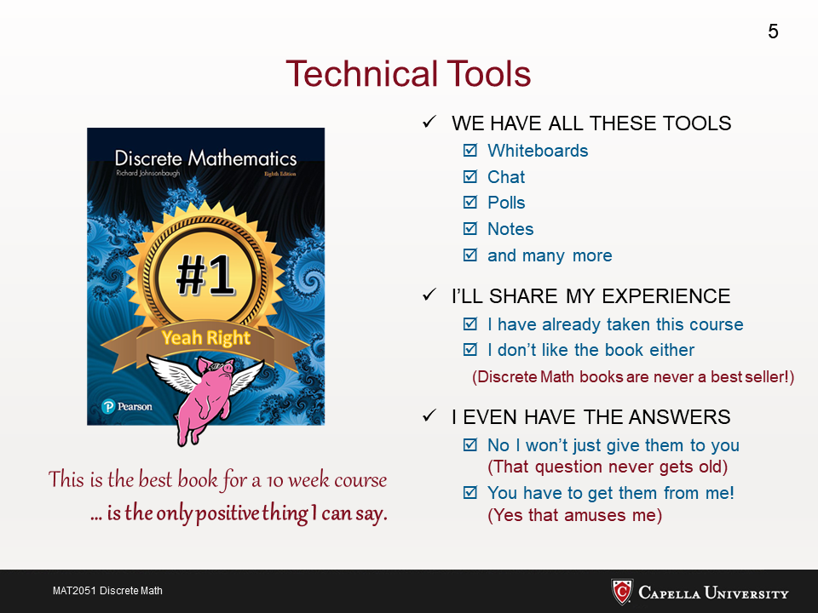

Slide 7
Our SI Meeting Room
We will be using Zoom for all SI meetings
Our meetings will take place 7:30-9:00 pm Central Time every Wed and Fri.
Attendance is 100% optional
The SI sessions will be recorded

Slide 8
Accessing SI Information
ALL SI information is centrally located in the SI Discussion area
The link there takes you to the “SI Home Page”
http://www.csci-snc.com/mat2051/
That’s where you’ll find links to everything that you’ll need… links to our Zoom meetings, links to the recordings, links to the PowerPoints, etc.
Please install: “chrome extension google docs offline”

Slide 9
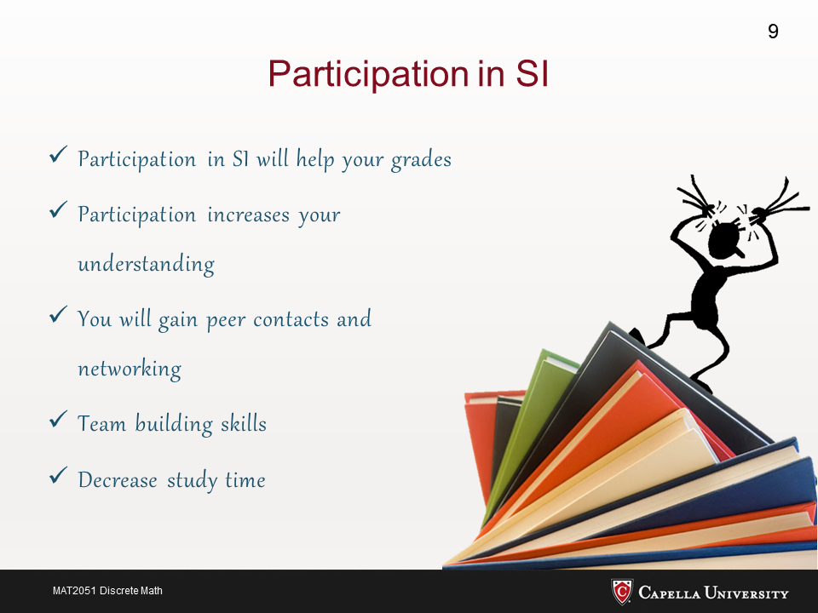

Slide 10
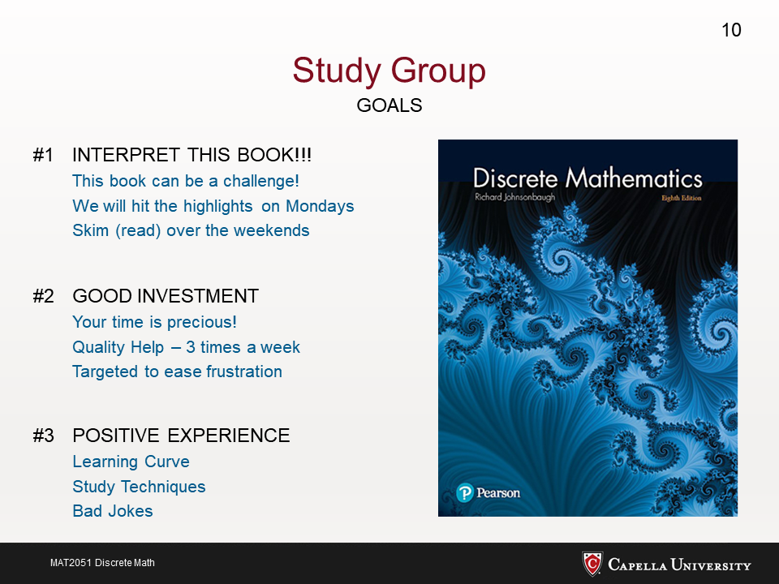

Slide 11
Writing math – Is there an Easier Way?
YES
MS Word has an Equation Editor:
https://www.youtube.com/watch?v=ge6a3wnAoUQ
https://support.microsoft.com/en-us/office/insert-mathematical-symbols-91a4b04c-84a8-4de9-bd13-8609e14bed58
https://support.microsoft.com/en-us/office/write-an-equation-or-formula-1d01cabc-ceb1-458d-bc70-7f9737722702

Slide 12
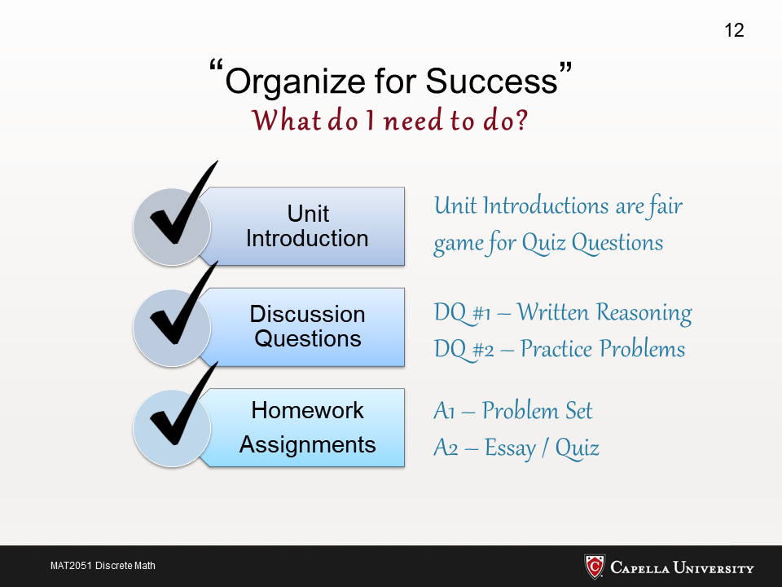

Slide 13
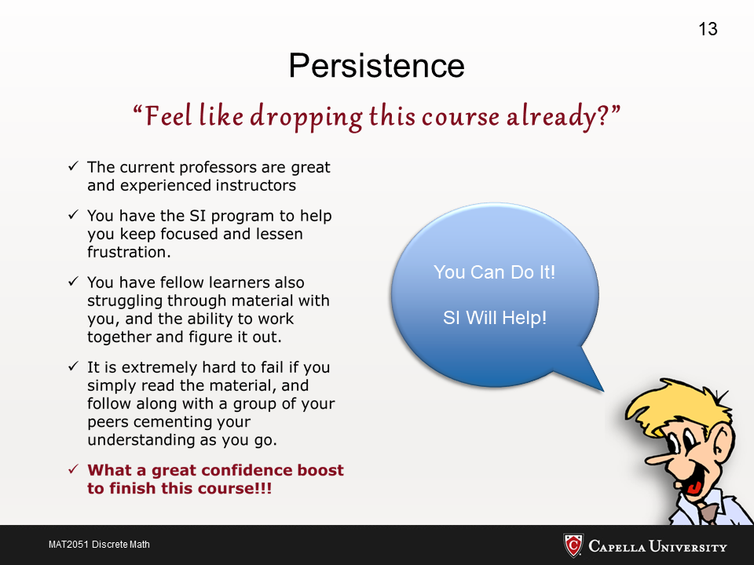

Slide 14
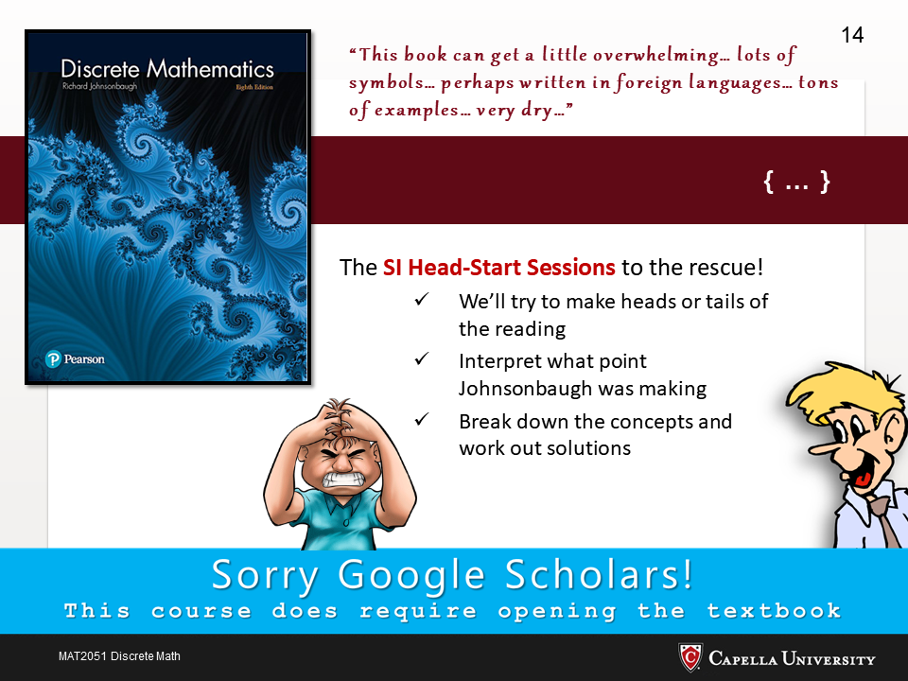

Slide 15
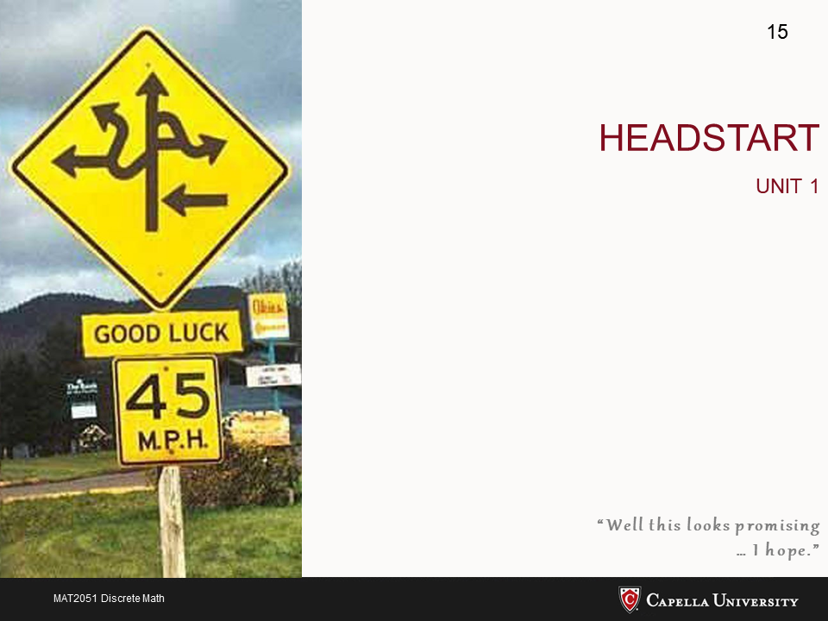

Slide 16
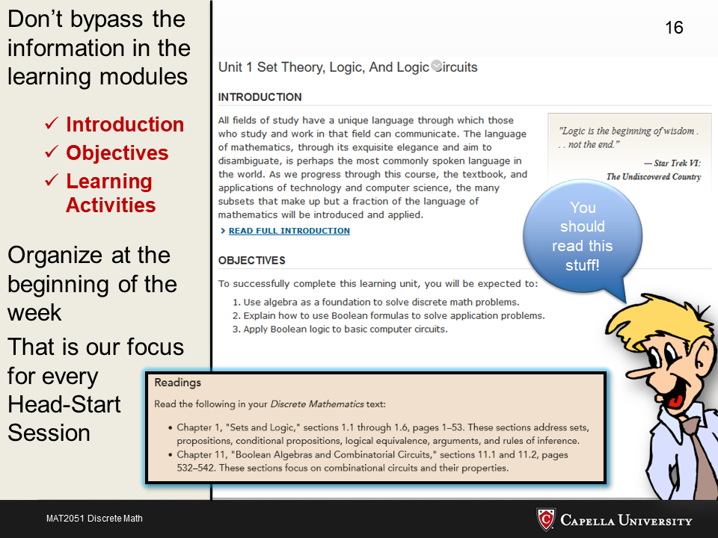

Slide 17
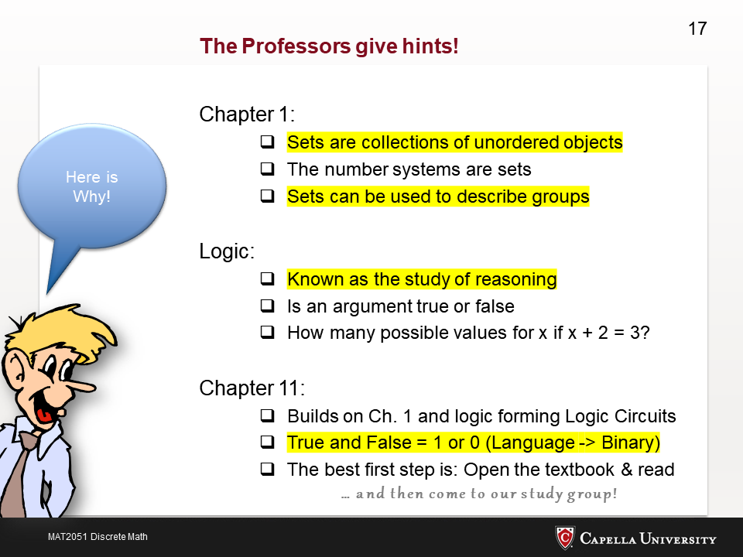

Slide 18
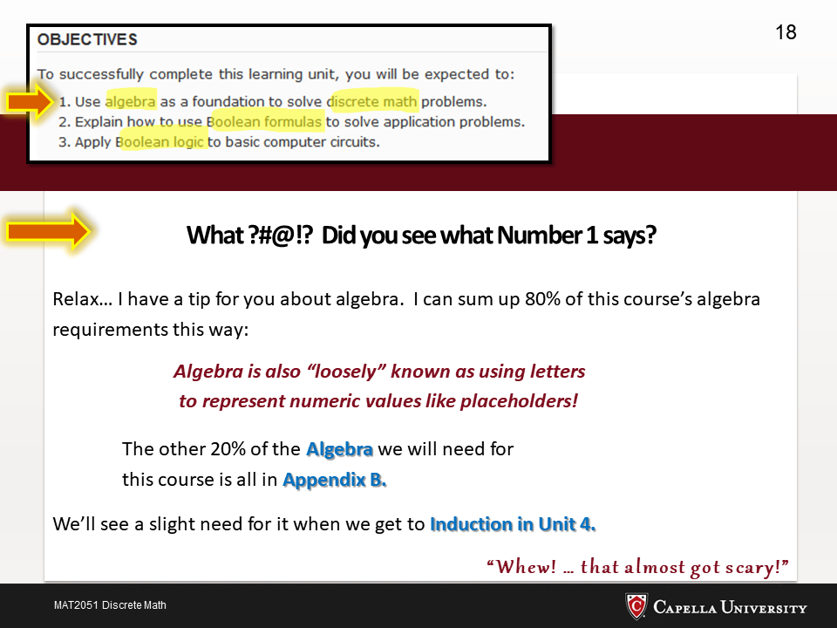

Slide 19
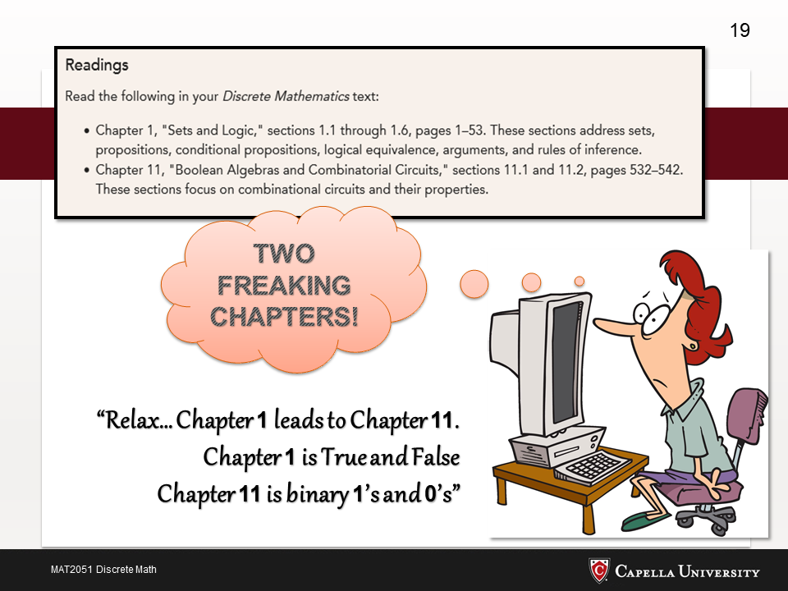

Slide 20
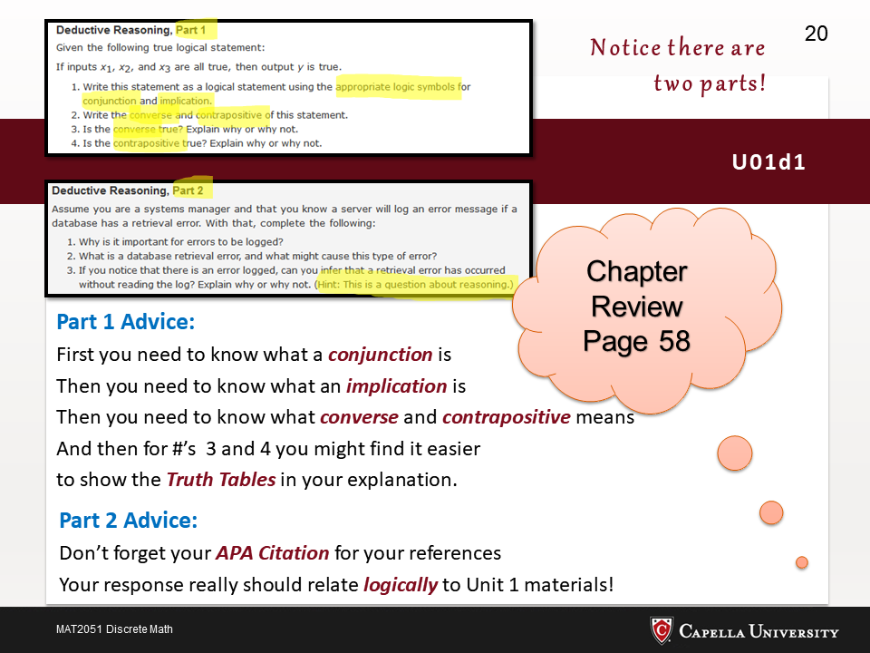

Slide 21
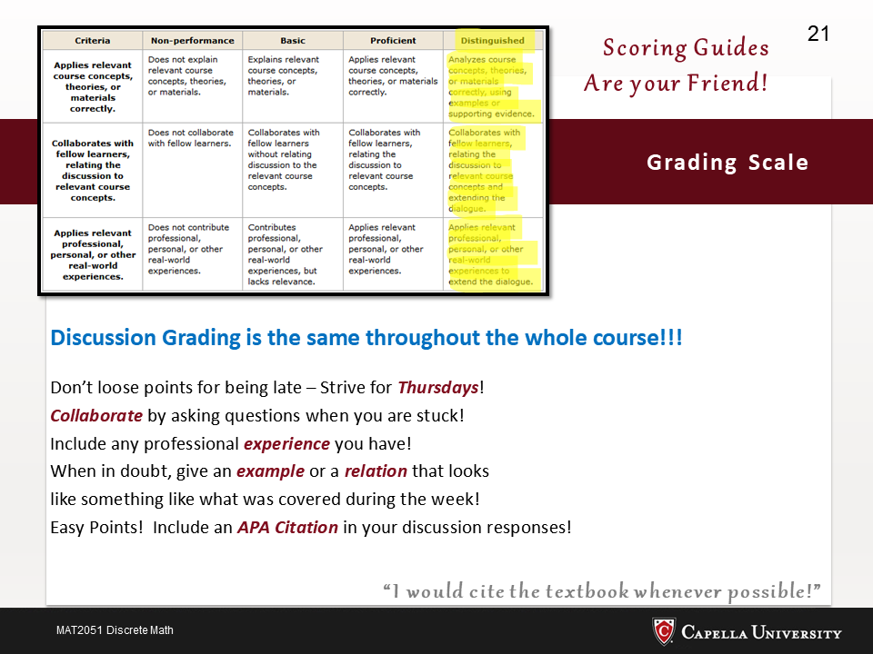

Slide 22
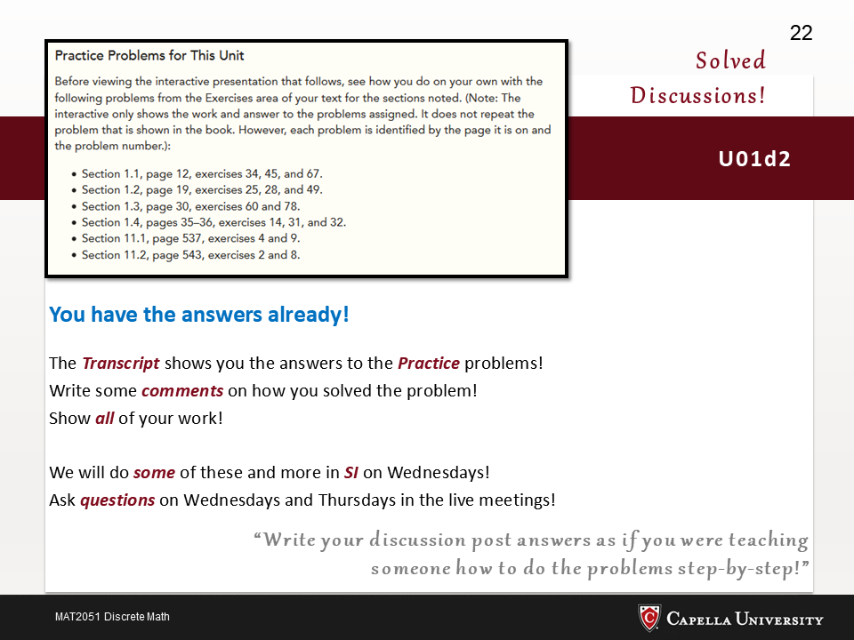

Slide 23
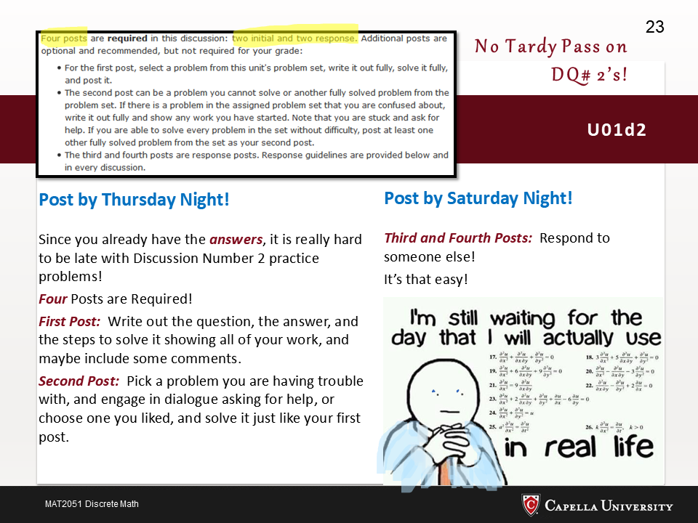

Slide 24
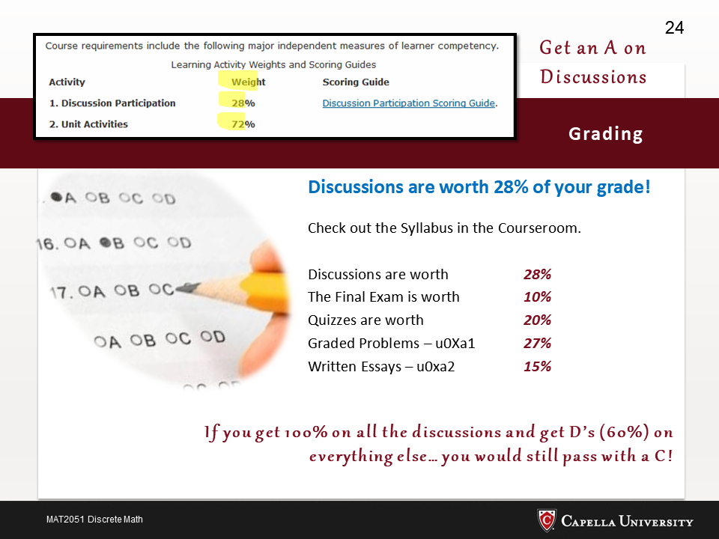

Slide 25
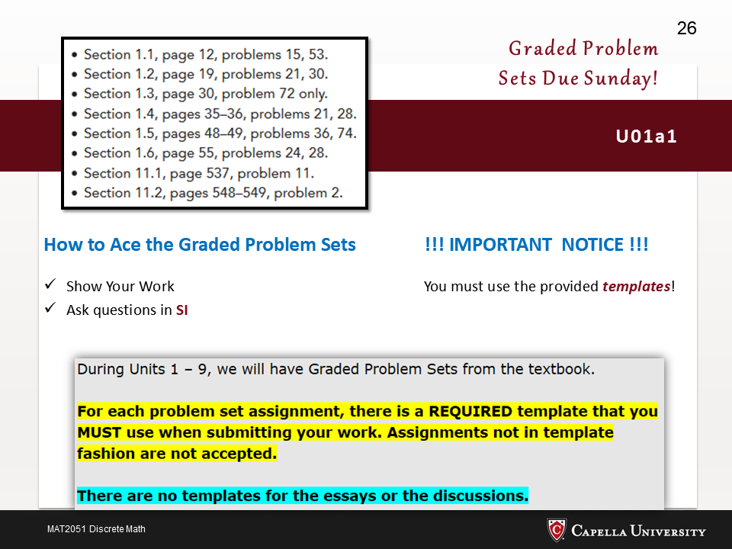

Slide 26
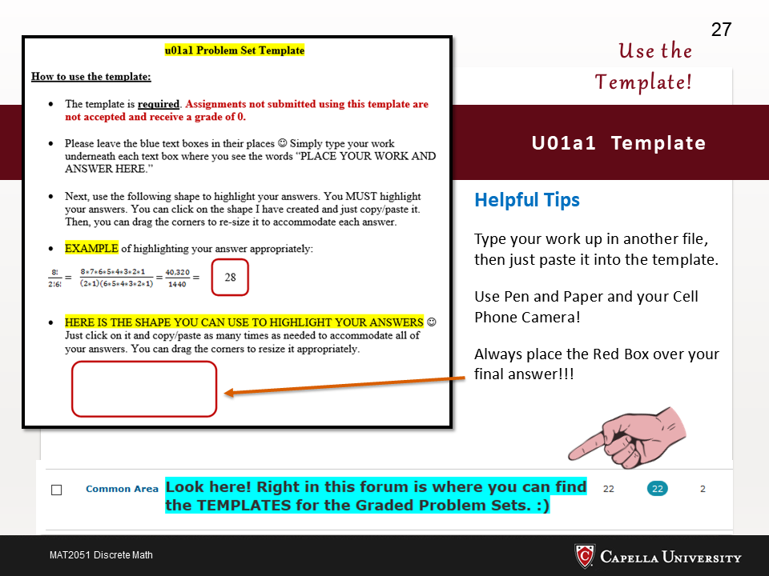

Slide 27
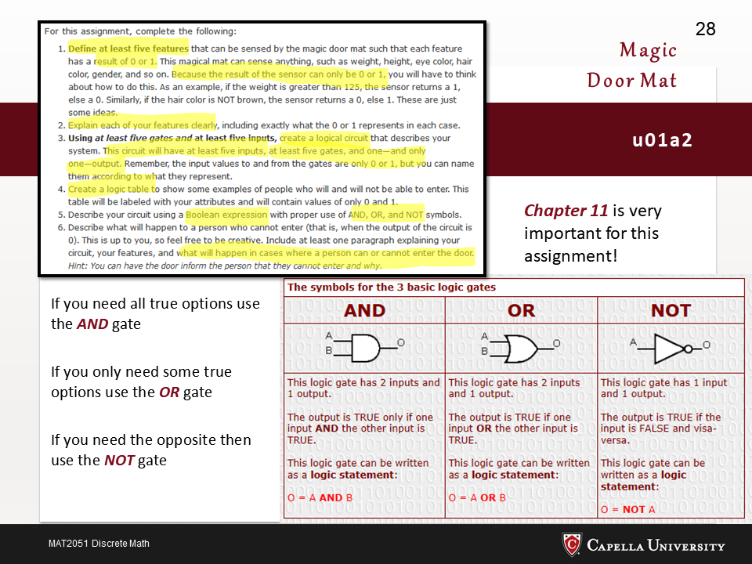

Slide 28
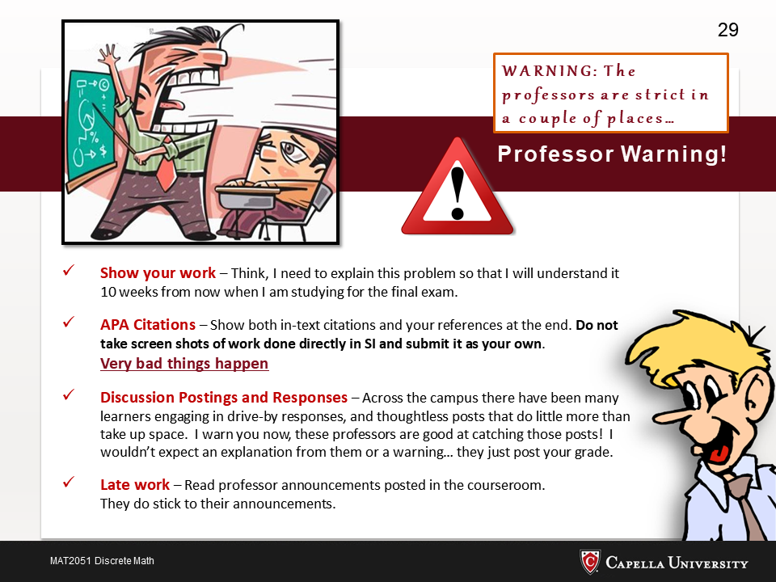

Slide 29
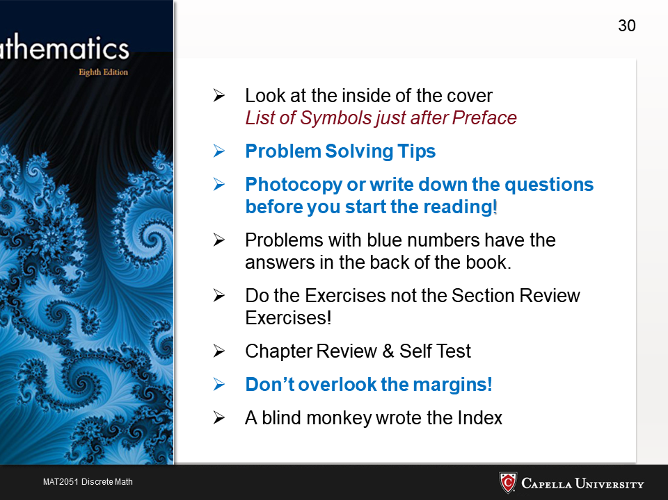

Slide 30
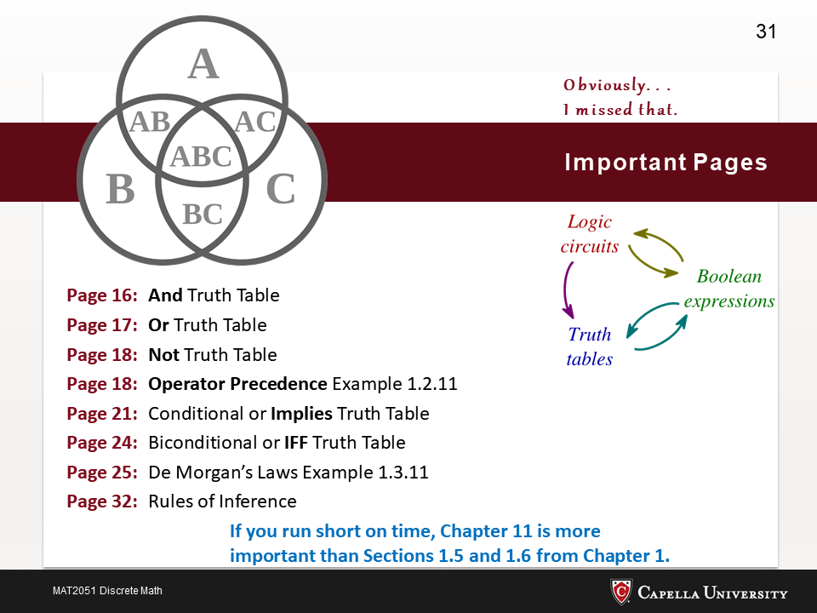

Slide 31
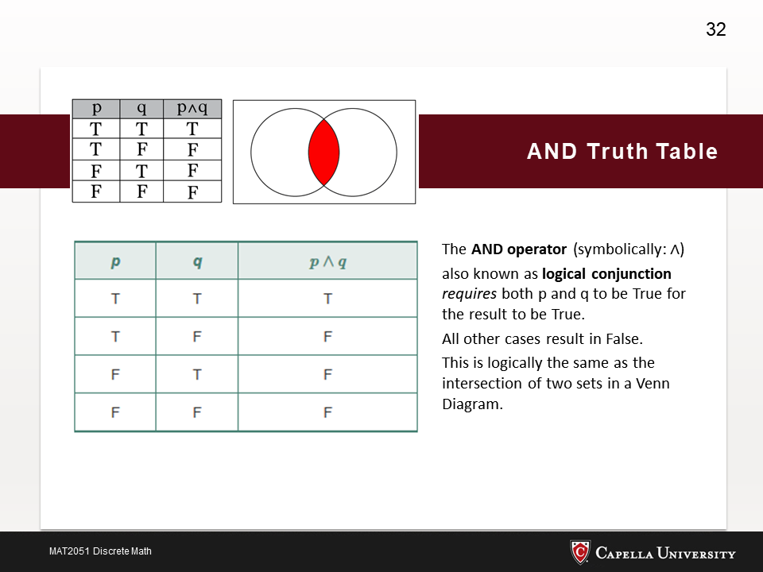

Slide 32
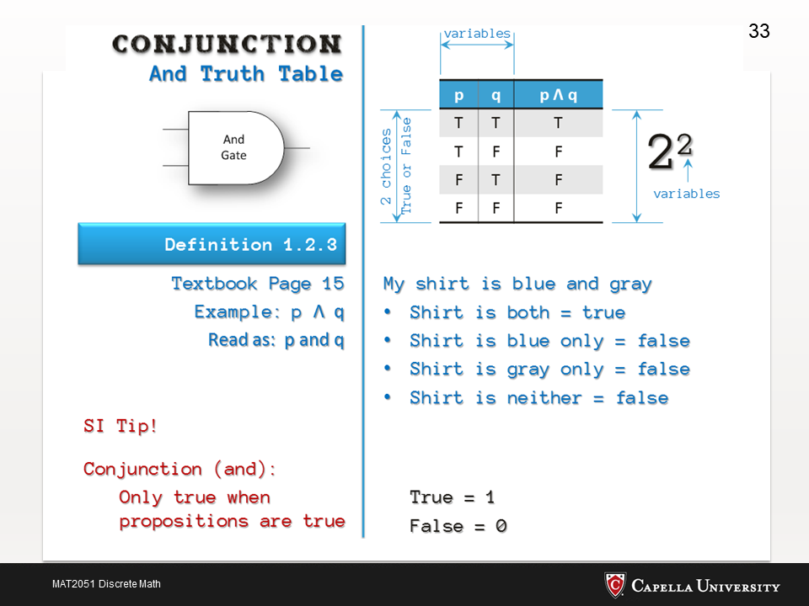

Slide 33
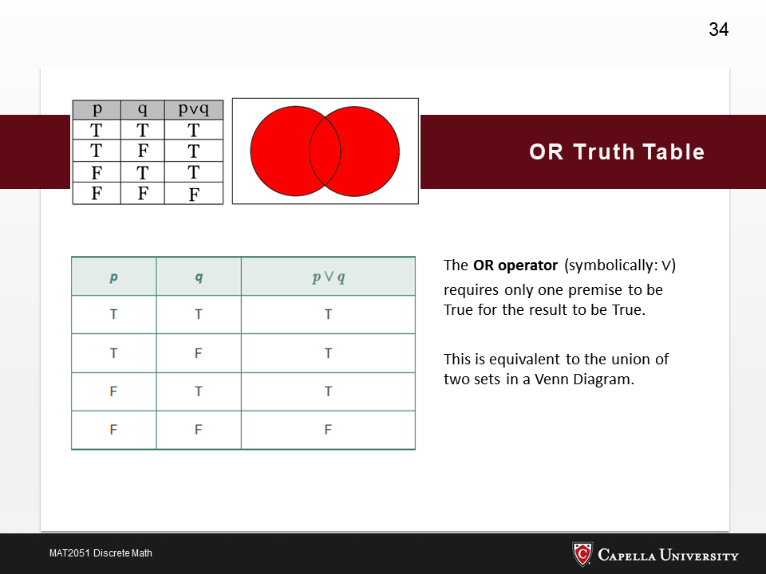

Slide 34
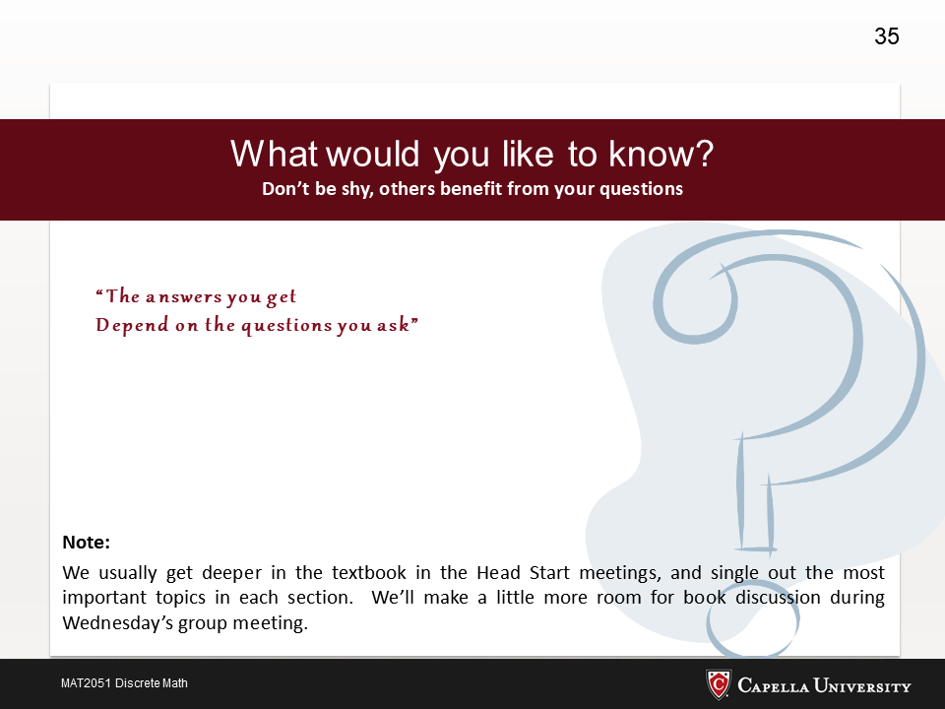

Slide 35
