Slide 1


Slide 2
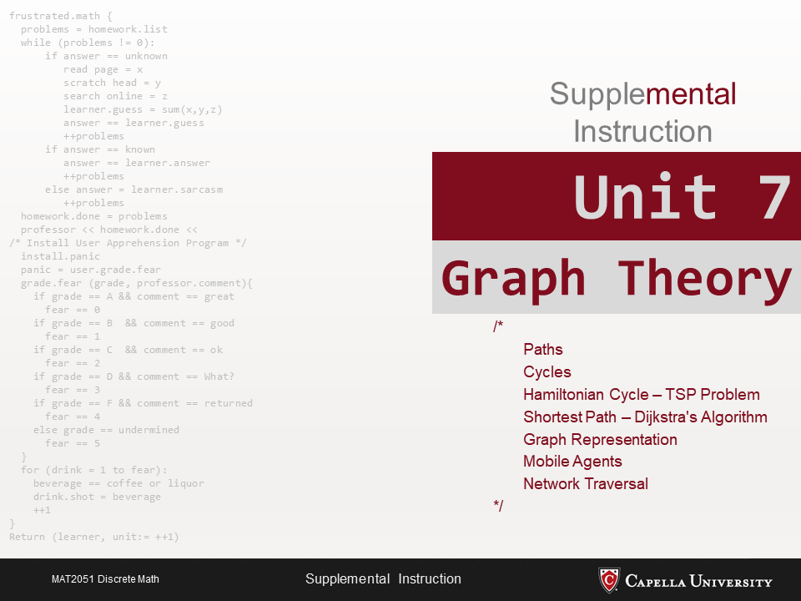

Slide 3
Definitions
Parallel edges: in an undirected graph, two or more edges that are incident to the same two vertices, or in a directed graph, two or more edges with both the same tail vertex and the same head vertex.
Let v and w be vertices in a graph G.
A simple path from v to w is a path from v to w with no repeated vertices.
A cycle (or circuit) is a path of nonzero length from v to v with no repeated edges.

Slide 4
Definitions…
A simple cycle is a cycle from v to v in which, except for the beginning and ending vertices that are both equal to v, there are no repeated vertices.
A cycle in a graph G that includes all the edges, and all the vertices of G is called a Euler cycle. (Every vertex has even degree.)
We call a cycle in a graph G that contains each vertex in G exactly once, except for the starting and ending vertex that appears twice, a Hamiltonian cycle.

Slide 5
Definitions…
A graph is planar if it can be drawn in the plane without its edges crossing.
A face of a graph is a region bounded by a set of edges and vertices. A face is characterized by the cycle that forms its boundary.
A Euler’s formula: f = e – v + 2 for connected planar graphs.
The sum of the degrees of all vertices in a graph is equal to twice the number of edges.
In any graph, the number of vertices of odd degree is even.
A simple graph is a graph without loops and multiple edges.

